Slide 1

Using member functions

Slide 2
Outline
In this lesson, we will:
See how to use member functions
Look at using member functions for the
std::cout object
Instances of the std::string class
Introduce the std::set class and its member functions
Observe that we don’t have to know about the constructors and destructors

Slide 3
Member functions
We discussed how we don’t want users accessing member variables
Instead, users should only be able to call functions associated with the class
Inside a function, you can make sure everything is correct when the function returns
How do we allow the author of the class to write functions that access member variables, but at the same time disallow users from writing similar functions?
Like member variables, a class can also have member functions
With member functions, we will call them in the exact way that we access member variables: with the . operator, only now we pass it arguments, as well

Slide 4
Calling member functions
Here is how member functions are called:
int main() {
std::cout << M_PI << std::endl;
std::cout.precision( 16 );
std::cout << M_PI << std::endl;
std::cout << std::sin( M_PI ) << std::endl;
std::cout.width( 10 );
std::cout << 42 << std::endl;
std::cout << 42 << std::endl;
std::cout.fill( '?' );
std::cout.width( 10 );
std::cout << 42 << std::endl;
std::cout << 42 << std::endl;
return 0;
}
Output:
3.14159
3.141592653589793
1.224646799147353e-16
42
42
????????42
42

Slide 5
Calling member functions
Here is how member functions are called:
int main() {
std::string greeting{ "G'day, for those of you..." };
std::cout << greeting << std::endl;
greeting.resize( greeting.length() - 3 ); // Reduce length by three
std::cout << greeting << std::endl;
greeting += " who don’t know us...";
std::cout << greeting << std::endl;
greeting.clear();
std::cout << "\"" << greeting << "\"" << std::endl;
return 0;
}
Output:
G'day, for those of you...
G'day, for those of you
G'day, for those of you who don’t know us...
""

Slide 6
Calling member functions
A call to a member function is a call on that specific object:
int main() {
std::string line1{ "Goose, goose, goose," };
std::string line2{ "You bend your neck towards the sky and sing." };
std::string line3{ "Your white feathers float on the green water," };
std::string line4{ "Your red feet push the clear waves." };
std::cout << line1.length() << std::endl std::cout << line2.length() << std::endl std::cout << line3.length() << std::endl std::cout << line4.length() << std::endl;
line3.replace( 33, 5, "emerald" );
std::cout << line3.length() << std::endl;
std::cout << line3 << std::endl;
return 0;
}
Output:
20
44
45
35
Your … the emerald water,
47

Slide 7
Understanding member functions
Given a class, once you know what the member functions are supposed to perform, you can now use the class without knowing anything about how that class is implemented
#include <set>
#include <iostream>
int main() {
std::set<int> data{};
for ( unsigned int k{0}; k < 10; ++k ) {
int n{};
std::cin >> n;
data.insert( n );
}
std::cout << "Number of entries: " << data.size() << std::endl;
std::cout << "Instances of 65: " << data.count( 65 ) << std::endl;
Input:
34 15 65 49 91 42 83 19 70 65
Output:
Number of entries: 9
Instances of 65: 1

Slide 8
Understanding member functions
std::cout << data.erase( 65 ) << std::endl;
std::cout << "Number of entries: " << data.size() << std::endl;
std::cout << data.erase( 65 ) << std::endl;
std::cout << "Number of entries: " << data.size() << std::endl;
for ( std::set<int>::iterator itr{ data.begin() };
itr != data.end() ; ++itr ) {
std::cout << " " << *itr;
}
return 0;
}
Output:
1
Number of entries: 8
0
Number of entries: 8
15 19 34 42 49 70 83 91

Slide 9
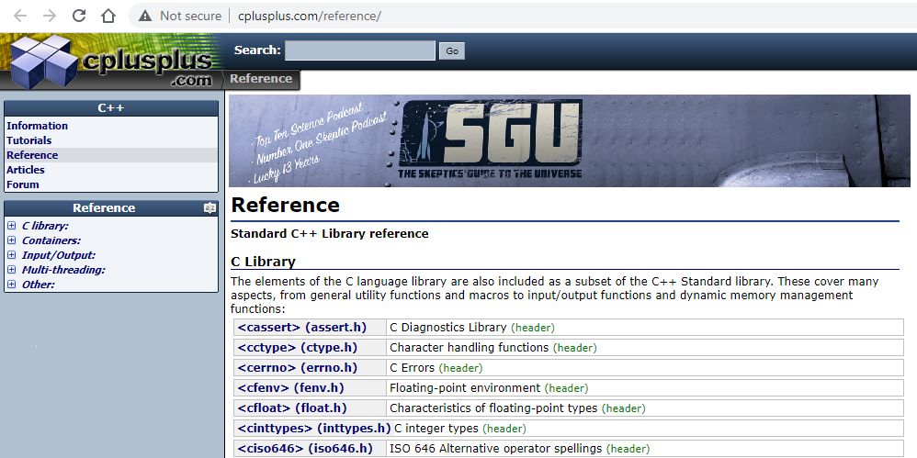
The standard library
The site cplusplus.com has an excellent interface for documenting the various classes and corresponding member functions of the standard library:
http://www.cplusplus.com/reference/
Containers have better ways of storing data than simple arrays

Slide 10
Constructors and destructors?
We emphasized there are three aspects that we must deal with:
The creation and initialization Constructors
The lifetime of the object Member functions
The clean-up prior to destruction Destructors
We didn’t have to deal with the constructors or the destructors because the compiler deal with these:
The constructor was called when the local variable was declared
The destructor was called when the local variable went out of scope

Slide 11
Summary
Following this lesson, you now
Understand how to use member functions
Have seen member functions for:
std::cout
std::string
std::set
Understand that the compiler schedules calls to the constructor and the destructor when a local variable is declared and when it goes out of scope

Slide 12
References
[1] https://en.wikipedia.org/wiki/C++_classes
[2] https://en.wikipedia.org/wiki/Standard_Template_Library

Slide 13



Colophon
These slides were prepared using the Georgia typeface. Mathematical equations use Times New Roman, and source code is presented using Consolas.
The photographs of lilacs in bloom appearing on the title slide and accenting the top of each other slide were taken at the Royal Botanical Gardens on May 27, 2018 by Douglas Wilhelm Harder. Please see
https://www.rbg.ca/
for more information.

Slide 14
Disclaimer
These slides are provided for the ece 150 Fundamentals of Programming course taught at the University of Waterloo. The material in it reflects the authors’ best judgment in light of the information available to them at the time of preparation. Any reliance on these course slides by any party for any other purpose are the responsibility of such parties. The authors accept no responsibility for damages, if any, suffered by any party as a result of decisions made or actions based on these course slides for any other purpose than that for which it was intended.

